Slide 1
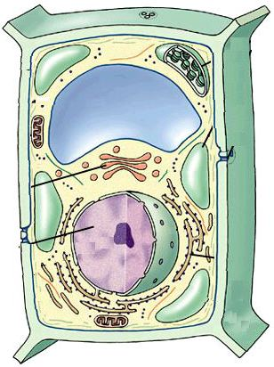
2 Protein Targeting pathways
Protein synthesis always
begins on free ribosomes
In cytoplasm
1) Post -translational: proteins
of plastids, mitochondria,
peroxisomes and nuclei
2) Endomembrane system
proteins are imported
co-translationally

Slide 2
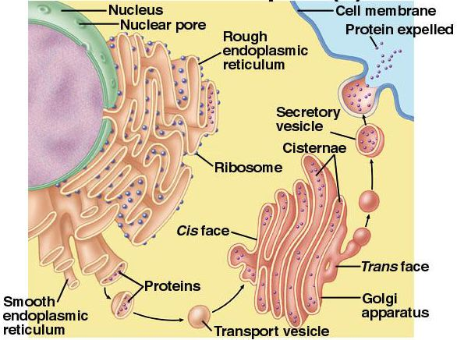
2 pathways for Protein Targeting
1) Post -translational
2) Co-translational: Endomembrane system proteins are imported co-translationally
inserted in RER
as they are made
transported to
final destination
in vesicles

Slide 3
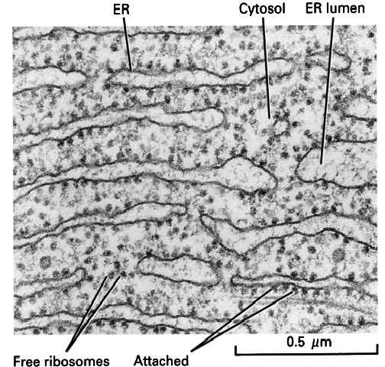
SIGNAL HYPOTHESIS
Protein synthesis begins on free ribosomes in cytoplasm
endomembrane proteins have "signal sequence"that directs them to RER
“attached” ribosomes are
tethered to RER by
the signal sequence

Slide 4
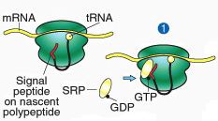
SIGNAL HYPOTHESIS
Protein synthesis begins on free ribosomes in cytoplasm
Endomembrane proteins have "signal sequence"that directs them to RER
SRP (Signal Recognition Peptide) binds signal sequence when it pops out of ribosome & swaps GDP for GTP

Slide 5
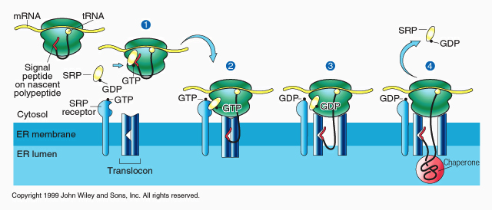
SIGNAL HYPOTHESIS
SRP stops protein synthesis until it binds “docking protein”(SRP receptor) in RER
Ribosome binds Translocon & secretes protein through it as it is made
BiP (a chaperone) helps the protein fold in the lumen

Slide 6
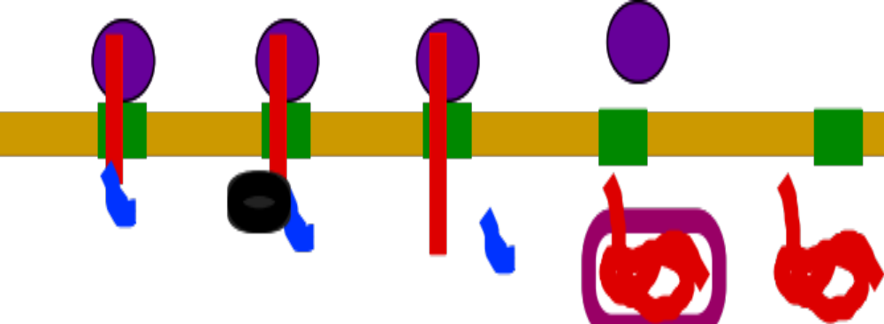
Subsequent events
Simplest case:
  1) signal is cleaved within lumen by signal peptidase
  2) BiP helps protein fold correctly
  3) protein is soluble inside lumen

Slide 7
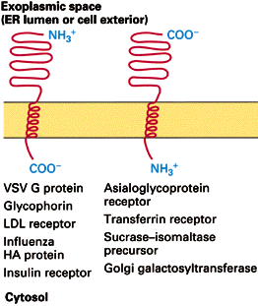
Subsequent events
Complications: proteins embedded in membranes

Slide 8
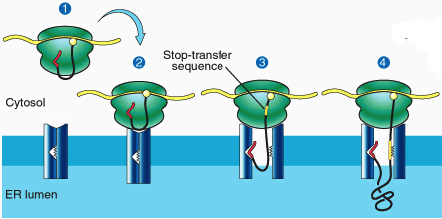
proteins embedded in membranes
protein has a stop-transfer sequence
  too hydrophobic to enter aqueous lumen

Slide 9
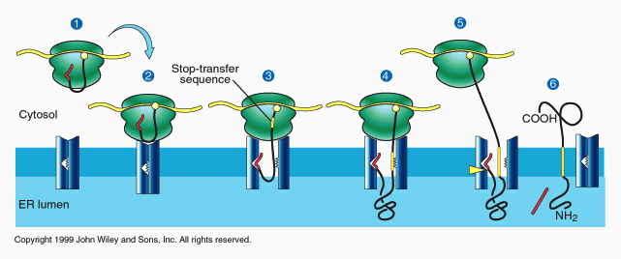
proteins embedded in membranes
protein has a stop-transfer sequence
  too hydrophobic to enter lumen
  therefore gets stuck in membrane
  ribosome releases translocon, finishes job in cytoplasm

Slide 10
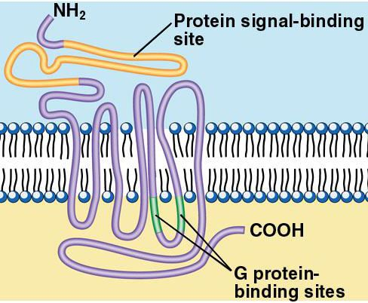
More Complications
Some proteins have multiple trans-membrane domains (e.g. G-protein-linked receptors)

Slide 11
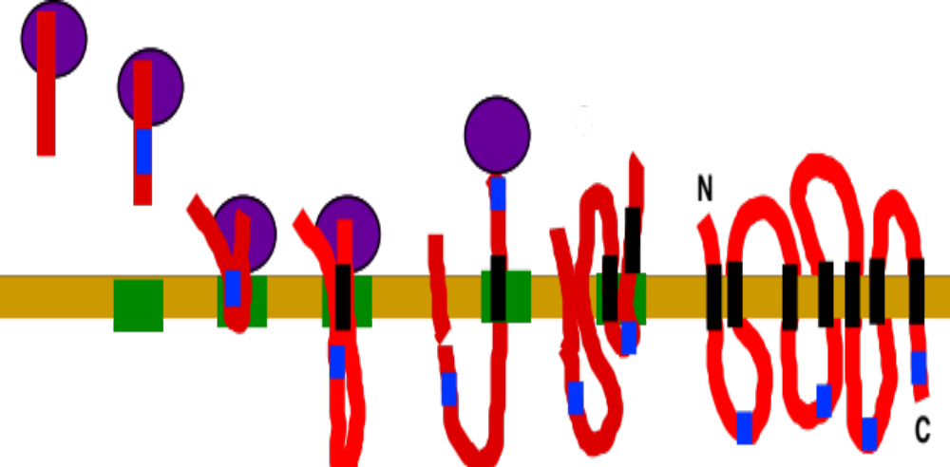
More Complications
Explanation: combinations of stop-transfer and internal signals
-> results in weaving the protein into the membrane

Slide 12
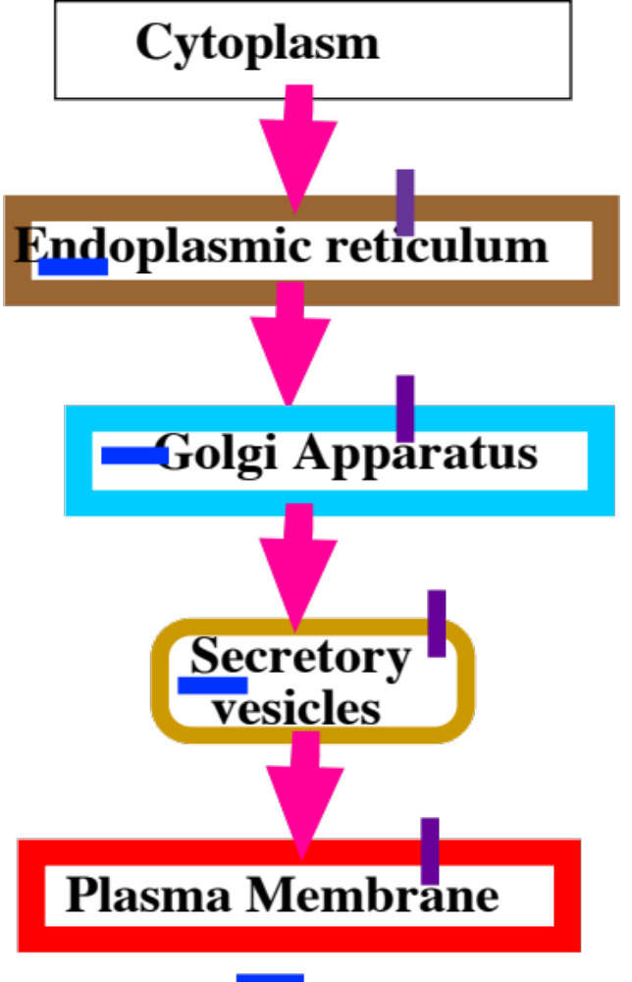
Sorting proteins made on RER
Simplest case: no sorting
proteins in RER lumen
are secreted

Slide 13
Sorting proteins made on RER
Simplest case: no sorting
proteins in RER lumen
are secreted
embedded proteins
go to plasma membrane

Slide 14
Sorting proteins made on RER
Redirection requires extra information:

Slide 15
Sorting proteins made on RER
Redirection requires extra information:
1) specific motif
2) receptors

Slide 16
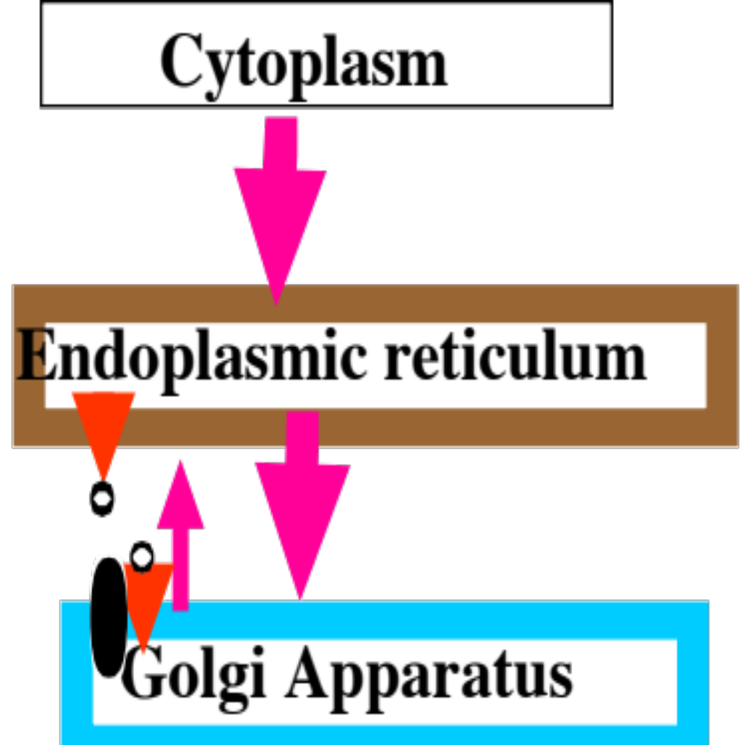
Sorting proteins made on RER
ER lumen proteins have KDEL (Lys-Asp-Glu-Leu) motif
Receptor in Golgi binds & returns these proteins
ER membrane proteins
have KKXX motif

Slide 17
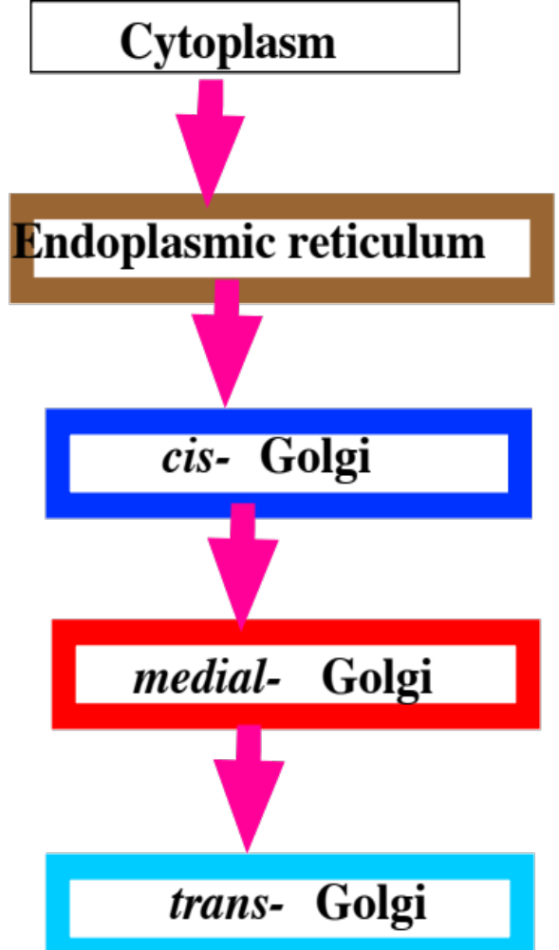
Sorting proteins made on RER
Golgi membrane proteins
cis- or medial- golgi proteins are
marked by sequences in the
membrane-spanning domain
trans-golgi proteins have a tyrosine-rich sequence in their cytoplasmic C-terminus

Slide 18
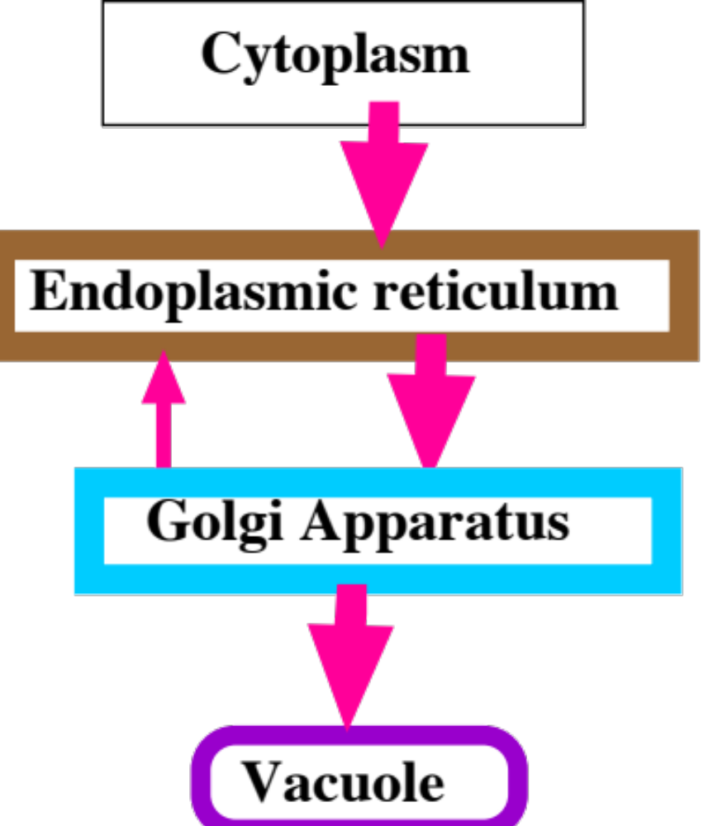
Sorting proteins made on RER
Plant vacuolar proteins are zymogens (proenzymes)
signal
VTS
mature protein
Barley aleurain
signal
mature protein
VTS
Barley lectin

Slide 19
Sorting proteins made on RER
Plant vacuolar proteins are zymogens (proenzymes), cleaved to mature form on arrival
targeting motif may be
at either end of protein
signal
VTS
mature protein
Barley aleurain
signal
mature protein
VTS
Barley lectin

Slide 20
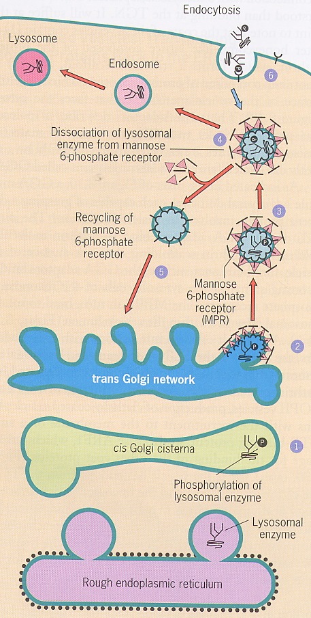
Sorting proteins made on RER
lysosomal proteins are targeted by mannose 6-phosphate
M 6-P receptors in trans-Golgi direct protein to lysosomes (via endosomes)
M 6-P is added in Golgi by enzyme that recognizes lysosomal motif

Slide 21
Glycosylation within ER
All endomembrane proteins are highly glycosylated on lumenal domains.
Glycosylation starts in the ER, continues in the Golgi

Slide 22
Glycosylation within ER
All endomembrane proteins are highly glycosylated on lumenal domains.
Glycosylation starts in ER, continues in Golgi
  makes proteins more hydrophilic
  essential for proper function
  tunicamycin poisons cells
  Glycosylation mutants are even sicker

Slide 23
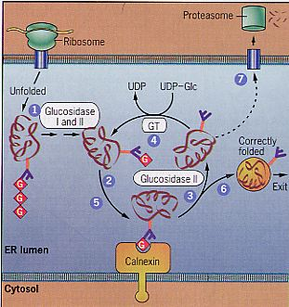
Glycosylation in RER
remove 2 glucose & bind to chaperone
If good, remove gluc 3 & send to Golgi
If bad, GT adds glucose
& try again
Eventually, send bad
proteins to cytosol
& eat them

Slide 24
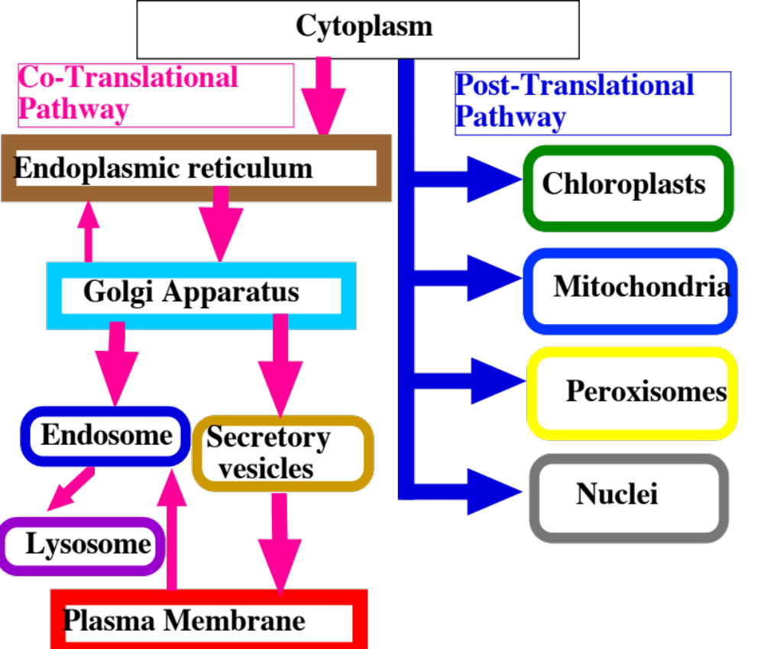

Slide 25
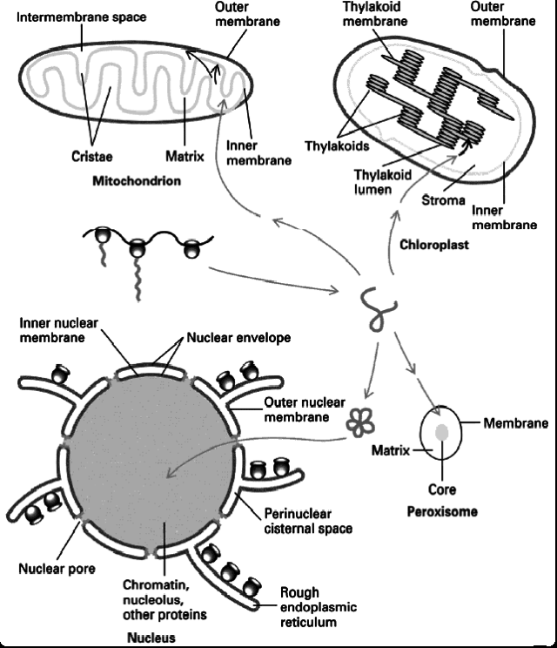
Post-translational protein targeting
Key features
1) imported after synthesis

Slide 26
Post-translational protein targeting
Key features
1) imported after synthesis
2) targeting information is motifs in protein
a) which organelle
b) site in organelle
3) Receptors guide it to correct site
4) no vesicles!

Slide 27
Protein targeting in Post-translational pathway
SKL (ser/lys/leu) at C terminus targets most peroxisomal matrix proteins = PTS1
In humans 3 are targeted by 9 aa at N terminus = PTS2
  Defective PTS2 receptor causes Rhizomelic chondrodysplasia punctata
N
SKL
C
N
PTS2
C

Slide 28
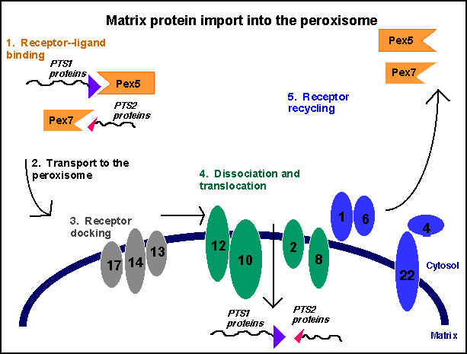
Targeting peroxisomal proteins
Bind receptor in cytoplasm
Dock with peroxisomal receptors
Import
protein w/o
unfolding it!
Recycle
receptors

Slide 29
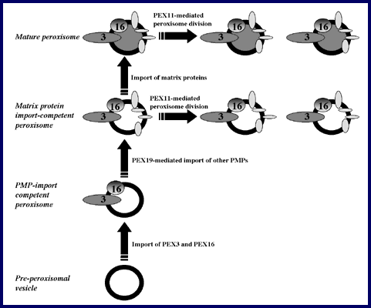
Peroxisomal Membrane Synthesis
Most peroxisomes arise by fission
can arise de novo!
Mechanism is poorly understood/ may involve ER!
Only need PEX 3 & PEX 16 to import pex membrane prot

Slide 30
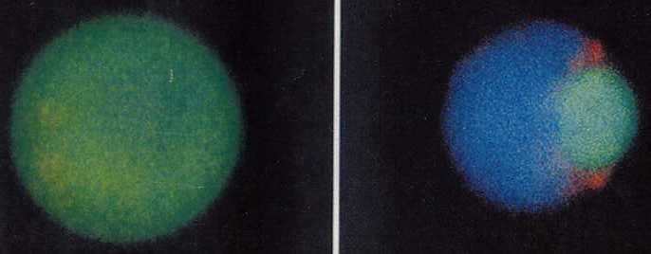
Protein import into nuclei
nuclear proteins are targeted by internal motifs
  necessary & sufficient to target cytoplasmic proteins to nucleus

Slide 31
Protein import into nuclei
nuclear proteins are targeted by internal motifs
  as in golgi, are not specific
  shapes cf sequences
  Receptors bind objects of the right shape!

Slide 32
  Protein import into nuclei
  3 types of NLS (nuclear localization sequence)
1) basic residues in DNA-binding region
+ + +
LZ

Slide 33
  Protein import into nuclei
  3 types of NLS (nuclear localization sequence)
1) basic residues in DNA-binding region
    2) SV-40 KKKRK
+ + +
LZ
KKKRK

Slide 34
Protein import into nuclei
3 types of NLS (nuclear localization sequence)
  1) basic residues in DNA-binding region
  2) SV-40 KKKRK
  3) bi-partite: 2-4 basic aa,10-20 aa spacer, 2-4 basic aa
+ + +
LZ
KKKRK
+ +
+ +

Slide 35
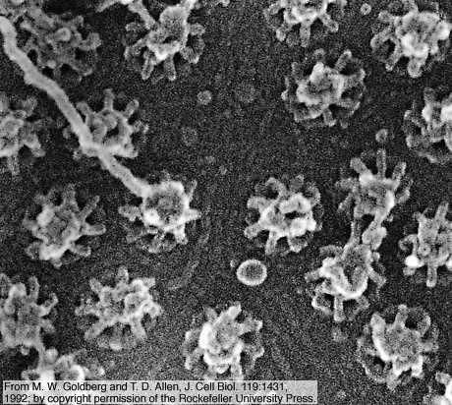
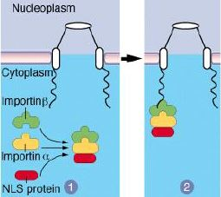
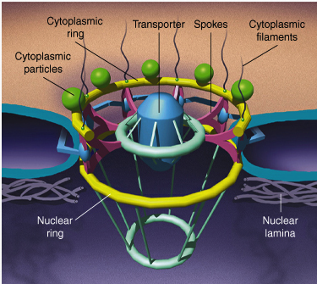
Protein import into nuclei
1) importin−α binds NLS importin−β binds complex
2) escort to nuclear pores
  Pores decide who can enter/exit nucleus

Slide 36
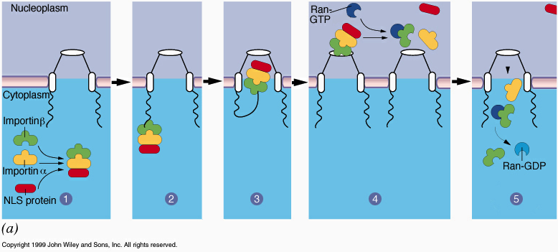
Protein import into nuclei
1) importin−α binds NLS, importin−β binds complex
2) escort to nuclear pores
3) transporter changes shape, lets complex enter
4) nuclear Ran-GTP dissociates complex
5) Ran-GTP returns β−importin to cytoplasm, becomes Ran-GDP. GTP -> GDP = nuclear import energy source
6) Exportins return α−importin & other cytoplasmic prot

